Slide 1



GD
Let’s have a
change of taste

Slide 2
enough of coding…
did you think your user’s gonna
use your app
Well, without Design?

Slide 3
enough of coding…
did you think your user’s gonna
use your app
Well, without Design?

Slide 4



INTRODUCING
MATERIAL
Material is an adaptable system of guidelines, components, and tools that support the best practices of user interface design. Backed by open-source code, Material streamlines collaboration between designers and developers, and helps teams quickly build beautiful products.
DESIGN
DESIGN
#theGoogleWay

Slide 5
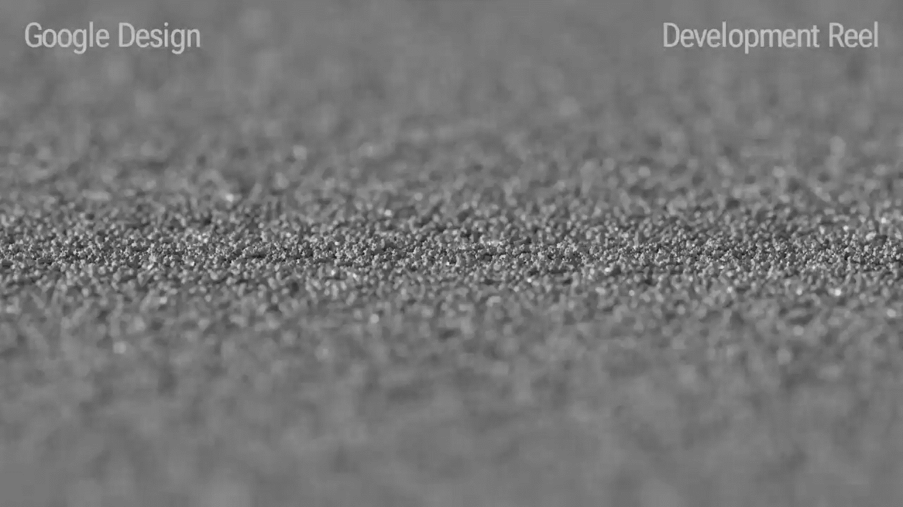
MATERIAL
DESIGN
Material is an adaptable system of guidelines, components, and tools that support the best practices of user interface design. Backed by open-source code, Material streamlines collaboration between designers and developers, and helps teams quickly build beautiful products.
The magic of
Material Design
Source: Linkedin

Slide 6
The magic of
Material Design
Source: Linkedin

Slide 7
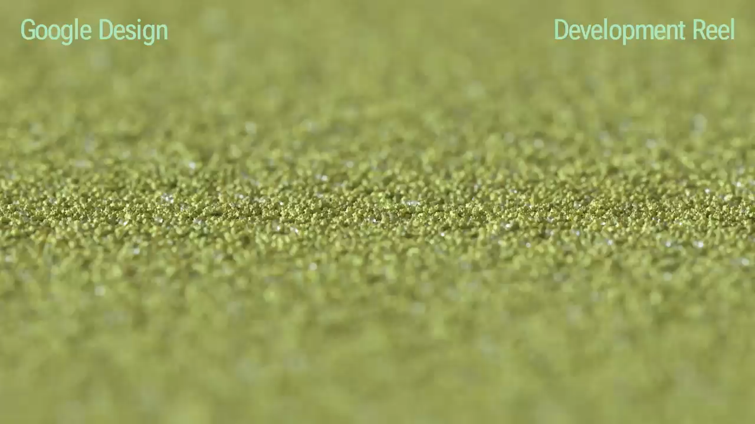
Source: Linkedin

Slide 8

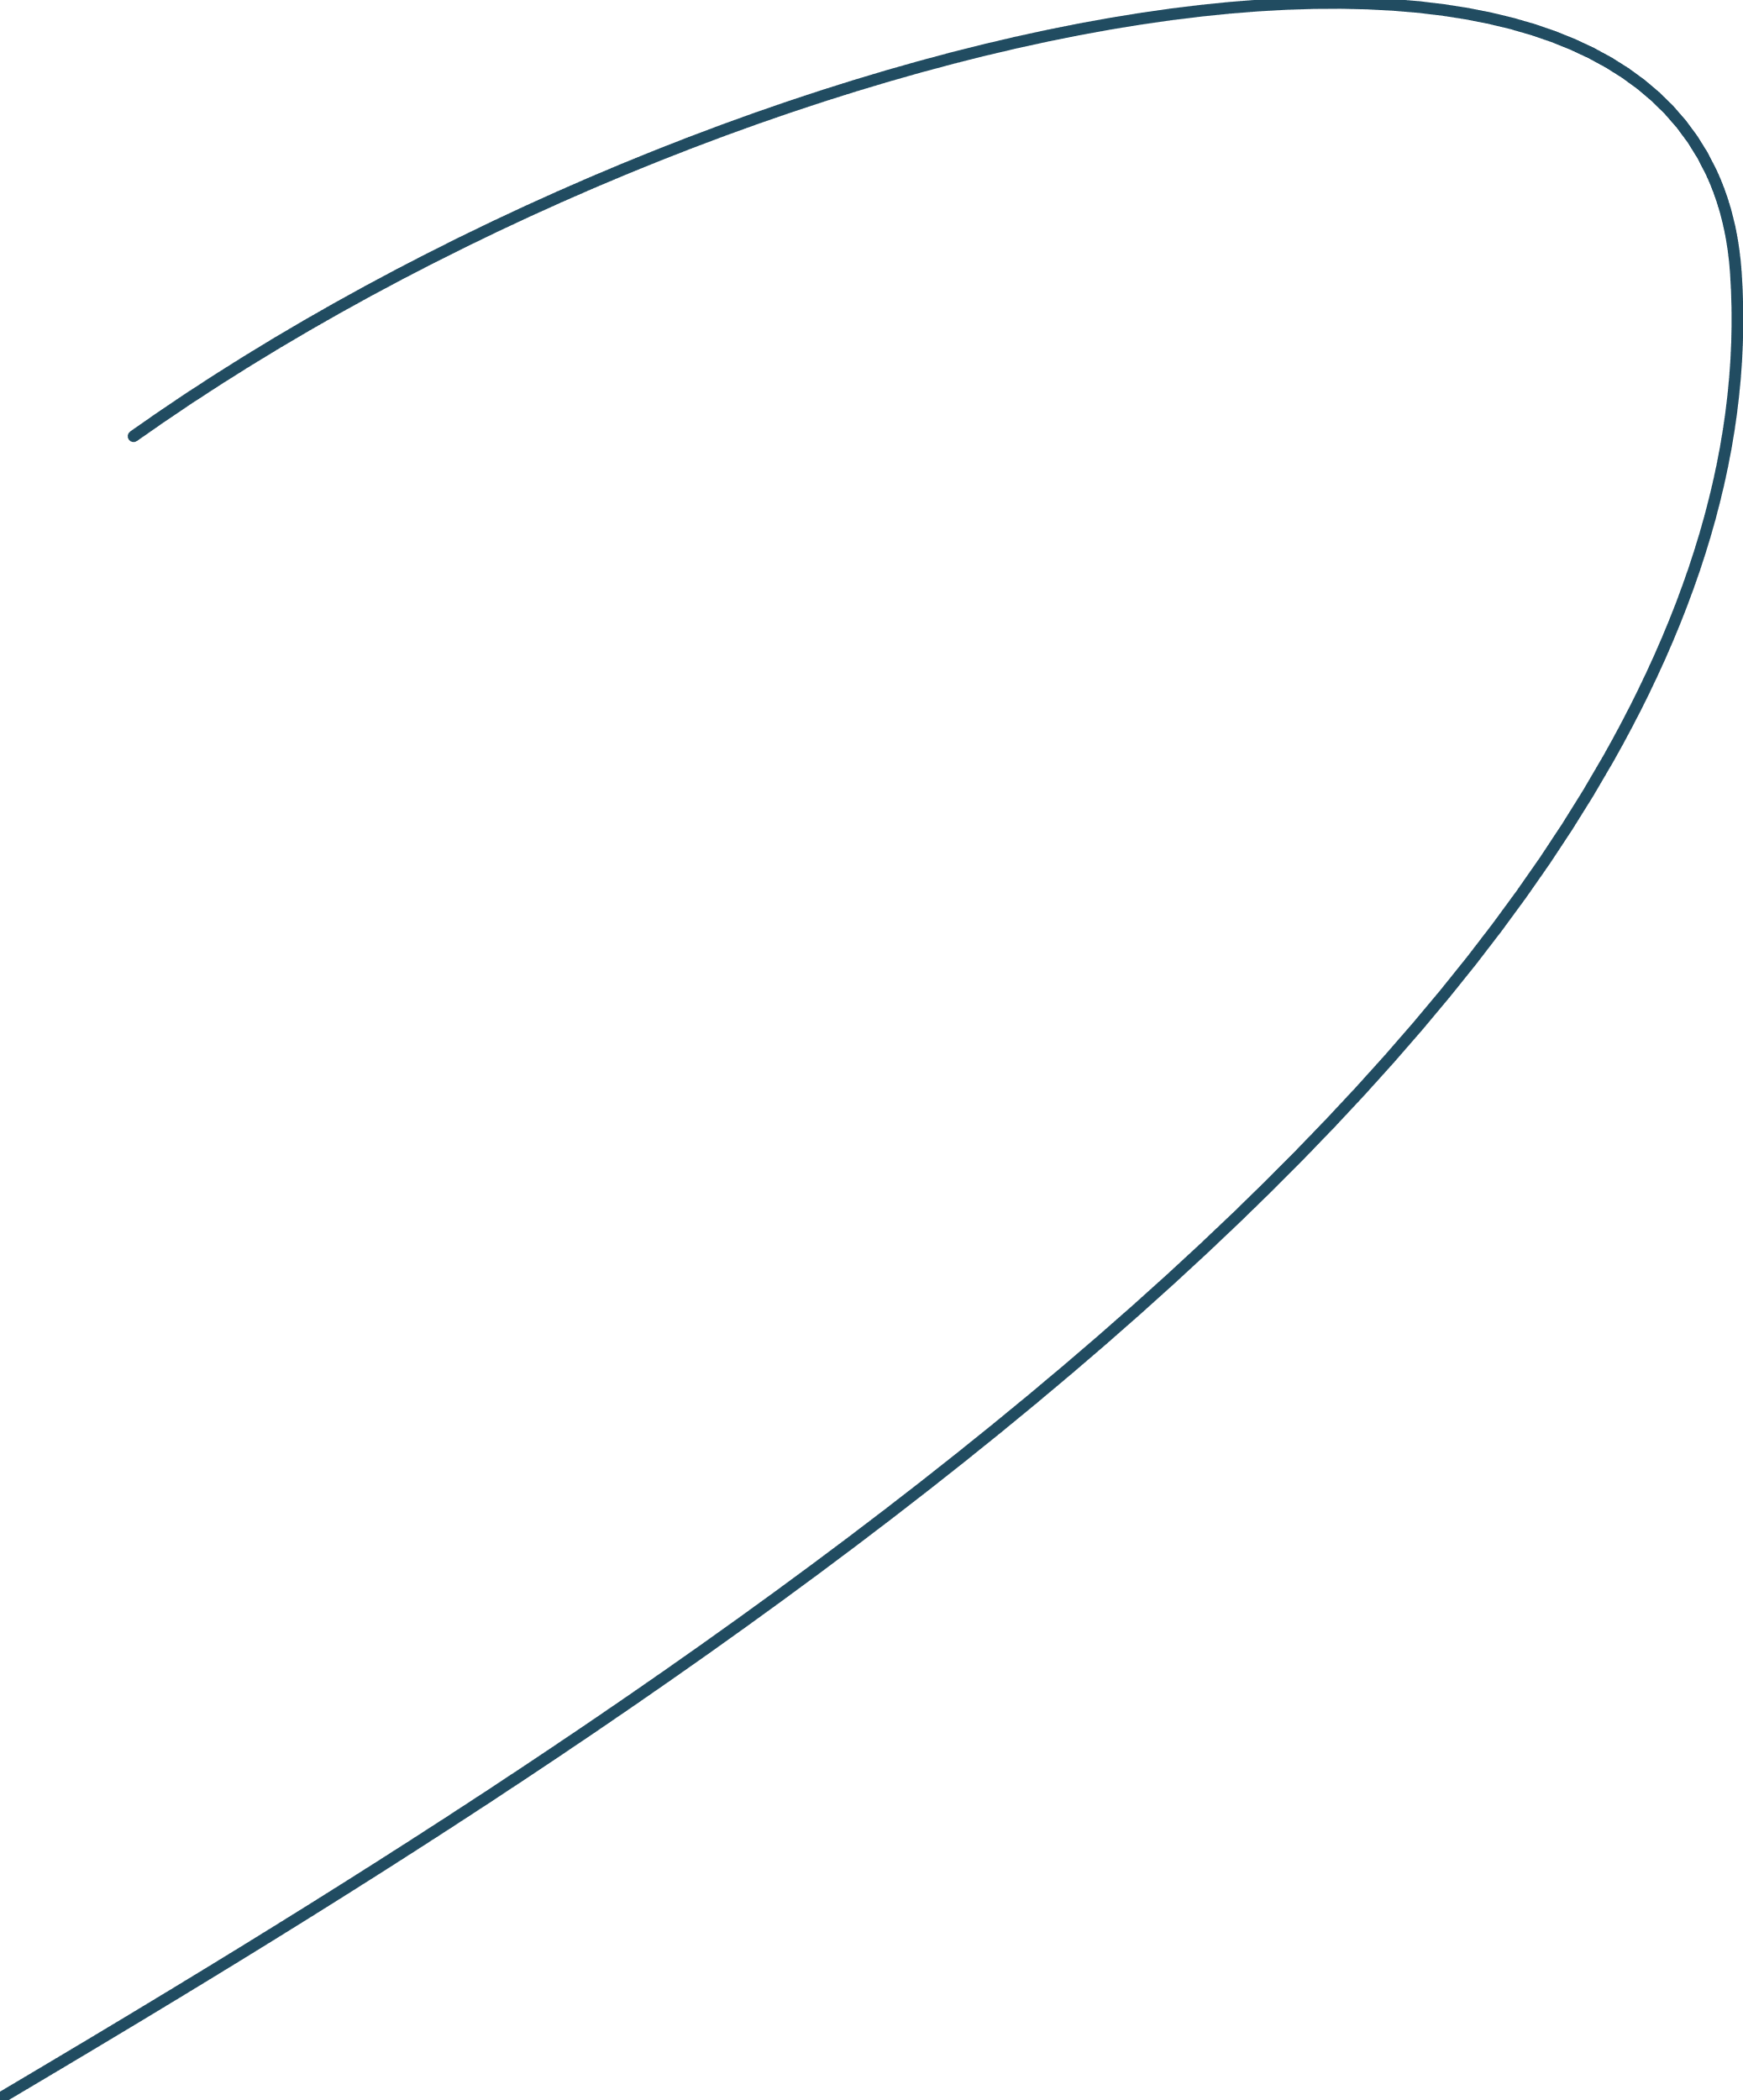
MATERIAL
DESIGN
So, let’s get started
with the foundations
Let’s consider
this button
Material Design defines the qualities that can be expressed by UI regions, surfaces, and components. Design and strategize how your app is built using foundations that address design from both a broad and detailed perspective.
G

Slide 9
MATERIAL
DESIGN
So, let’s get started
with the foundations
Let’s consider
this button
Material Design defines the qualities that can be expressed by UI regions, surfaces, and components. Design and strategize how your app is built using foundations that address design from both a broad and detailed perspective.
G

Slide 10
MATERIAL
DESIGN
So, let’s get started
with the foundations
Let’s consider
this button
Material Design defines the qualities that can be expressed by UI regions, surfaces, and components. Design and strategize how your app is built using foundations that address design from both a broad and detailed perspective.
G
G

Slide 11
MATERIAL
DESIGN
So, let’s get started
with the foundations
Let’s consider
this button
Material Design defines the qualities that can be expressed by UI regions, surfaces, and components. Design and strategize how your app is built using foundations that address design from both a broad and detailed perspective.
G
G

Slide 12
MATERIAL
DESIGN
So, let’s get started
with the foundations
Let’s consider
this button
Material Design defines the qualities that can be expressed by UI regions, surfaces, and components. Design and strategize how your app is built using foundations that address design from both a broad and detailed perspective.
G
G
G

Slide 13
MATERIAL
DESIGN
So, let’s get started
with the foundations
Let’s consider
this button
Material Design defines the qualities that can be expressed by UI regions, surfaces, and components. Design and strategize how your app is built using foundations that address design from both a broad and detailed perspective.
G
G
G
G

Slide 14
MATERIAL
DESIGN
So, let’s get started
with the foundations
Let’s consider
this button
Material Design defines the qualities that can be expressed by UI regions, surfaces, and components. Design and strategize how your app is built using foundations that address design from both a broad and detailed perspective.
G
G
G
G

Slide 15
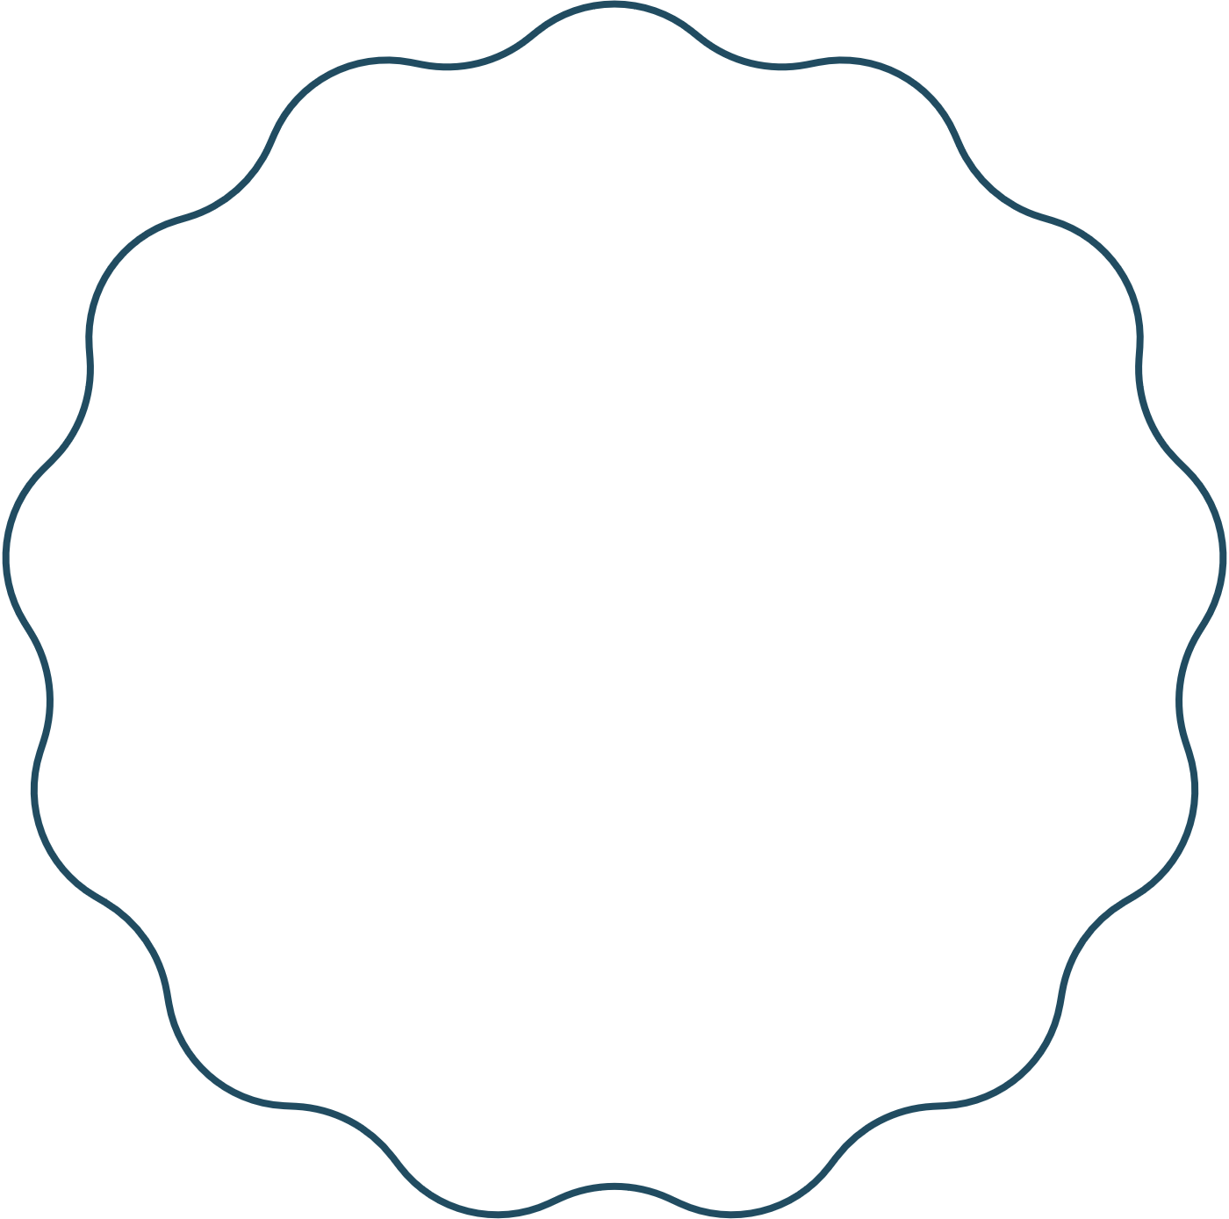

MATERIAL
DESIGN
Understanding layout
Material Design layouts use uniform elements and spacing to encourage consistency across platforms, environments, and screen sizes.
Let’s consider
this button
G
G
G
G

Slide 16
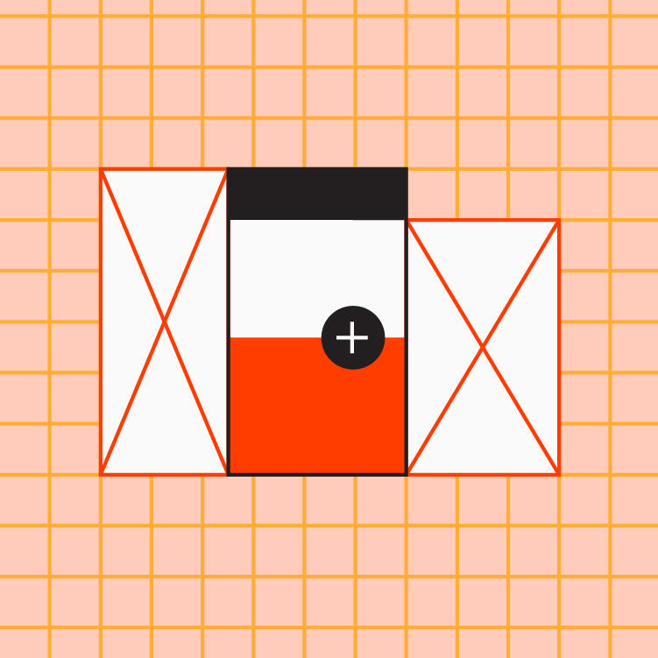
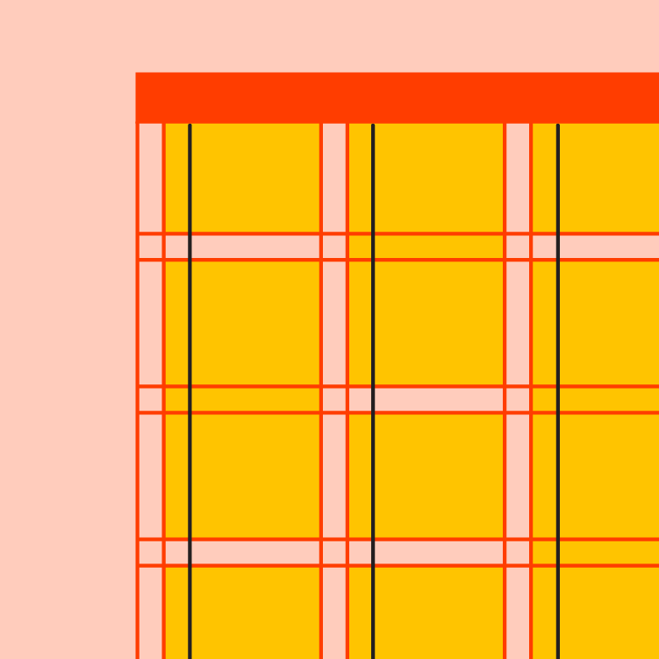
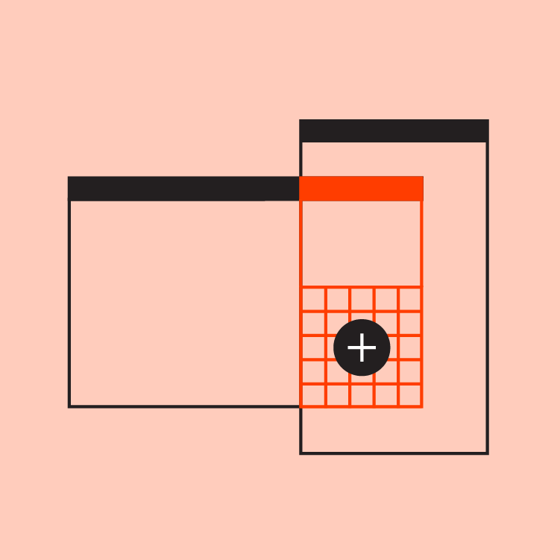
MATERIAL
DESIGN
with the principles
Understanding layout
Material Design layouts use uniform elements and spacing to encourage consistency across platforms, environments, and screen sizes.
Predictable
Consistent
Responsive

Slide 17
MATERIAL
DESIGN
Layout Anatomy
Let’s imagine
the basic layout of a
web application
Layout regions are the foundation for interactive experiences. They’re a layout’s building blocks and are composed of elements and components that share a similar function. Layout regions can also group smaller containers such as cards.

Slide 18
MATERIAL
DESIGN
Layout Anatomy
Let’s imagine
the basic layout of a
web application
Layout regions are the foundation for interactive experiences. They’re a layout’s building blocks and are composed of elements and components that share a similar function. Layout regions can also group smaller containers such as cards.

Slide 19



MATERIAL
DESIGN
Layout Anatomy
App Bar
Layout regions are the foundation for interactive experiences. They’re a layout’s building blocks and are composed of elements and components that share a similar function. Layout regions can also group smaller containers such as cards.
Body
Navigation

Slide 20
Subheader
MATERIAL
DESIGN
Responsive layout grid
Material Design’s responsive layout grid adapts to screen size and orientation, ensuring consistency across layouts. The responsive layout grid is made up of three elements: columns, gutters, and margins.

Slide 21
MATERIAL
DESIGN
Columns
Content is placed in the areas of the screen that contain columns.
In responsive layouts, column width is defined with percentages, rather than fixed values. This allows content to adapt to any screen size. The number of columns displayed in the grid is determined by the breakpoint range, a range of predetermined screen sizes. A breakpointcan correspond with mobile, tablet, or other screen type.
Margins
Subheader
Columns
Gutters

Slide 22
MATERIAL
DESIGN
Columns
Content is placed in the areas of the screen that contain columns.
In responsive layouts, column width is defined with percentages, rather than fixed values. This allows content to adapt to any screen size. The number of columns displayed in the grid is determined by the breakpoint range, a range of predetermined screen sizes. A breakpointcan correspond with mobile, tablet, or other screen type.
Gutters
A gutter is the space between columns that helps separate content.
Gutter widths are fixed values at each breakpoint range. To better adapt to a given screen size, gutter widths can change at different breakpoints. Wider gutters are more appropriate for larger screens, as they create more open space between columns.
Margins
Subheader
Columns
Gutters

Slide 23
MATERIAL
DESIGN
Margins
Margins are the space between content and the left and right edges of the screen.
Margin widths are defined using fixed or scaling values at each breakpoint range. To better adapt to the screen, the margin width can change at different breakpoints. Wider margins are more appropriate for larger screens, as they create more whitespace around the perimeter of content.
Gutters
A gutter is the space between columns that helps separate content.
Gutter widths are fixed values at each breakpoint range. To better adapt to a given screen size, gutter widths can change at different breakpoints. Wider gutters are more appropriate for larger screens, as they create more open space between columns.
Margins
Subheader
Columns
Gutters

Slide 24
MATERIAL
DESIGN
Margins
Margins are the space between content and the left and right edges of the screen.
Margin widths are defined using fixed or scaling values at each breakpoint range. To better adapt to the screen, the margin width can change at different breakpoints. Wider margins are more appropriate for larger screens, as they create more whitespace around the perimeter of content.
Margins
Subheader
Columns
Gutters

Slide 25

MATERIAL
DESIGN
Colors and theming
Color themes are designed to be harmonious, ensure accessible text, and distinguish UI elements and surfaces from one another.
LET’S TALK

Slide 26
MATERIAL
DESIGN
Color usage and palettes
Colors and theming
Color themes are designed to be harmonious, ensure accessible text, and distinguish UI elements and surfaces from one another.
The Material Design color system helps you apply color to your UI in a meaningful way. In this system, you select a primary and a secondary color to represent your brand. Dark and light variants of each color can then be applied to your UI in different ways.
P
900 800 700 600 500 400 300 200 100 50
P

Slide 27
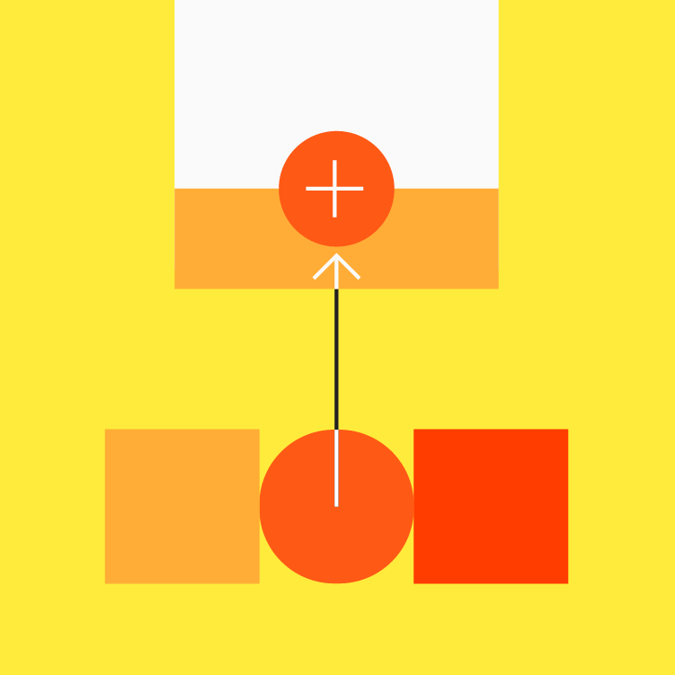
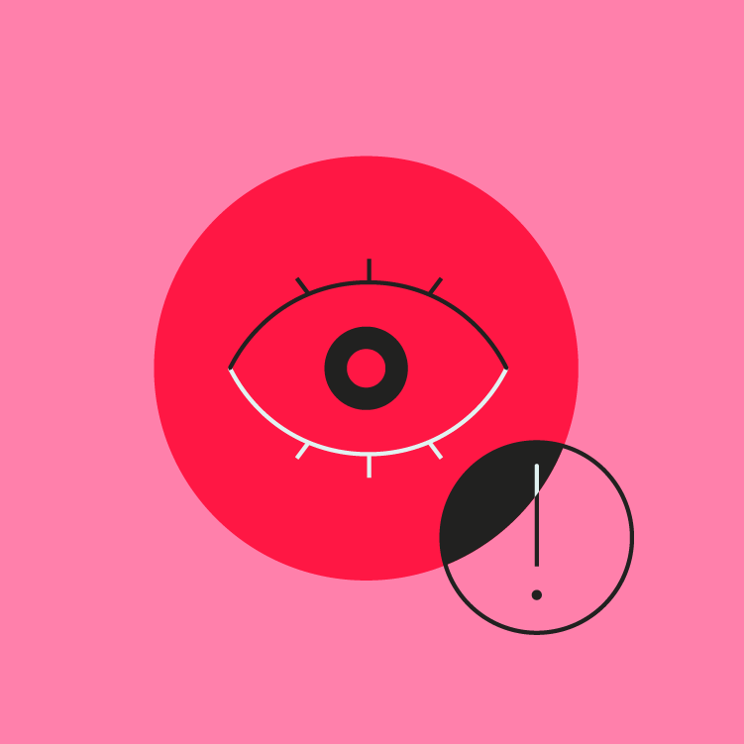
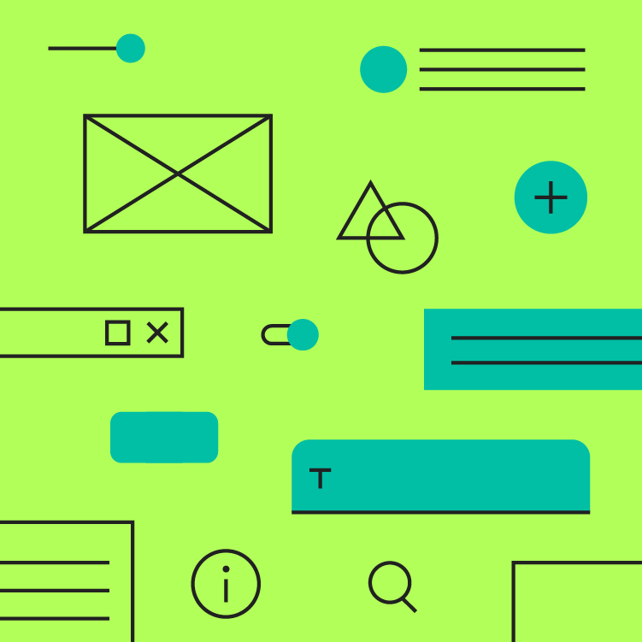
MATERIAL
DESIGN
Color usage and palettes
with the principles
The Material Design color system helps you apply color to your UI in a meaningful way. In this system, you select a primary and a secondary color to represent your brand. Dark and light variants of each color can then be applied to your UI in different ways.
Expressive
Legible
Hierarchical

Slide 28


Dark and light secondary variants
Distinguish UI elements

Slide 29
Adaptive theming
Dark and light secondary variants

Slide 30
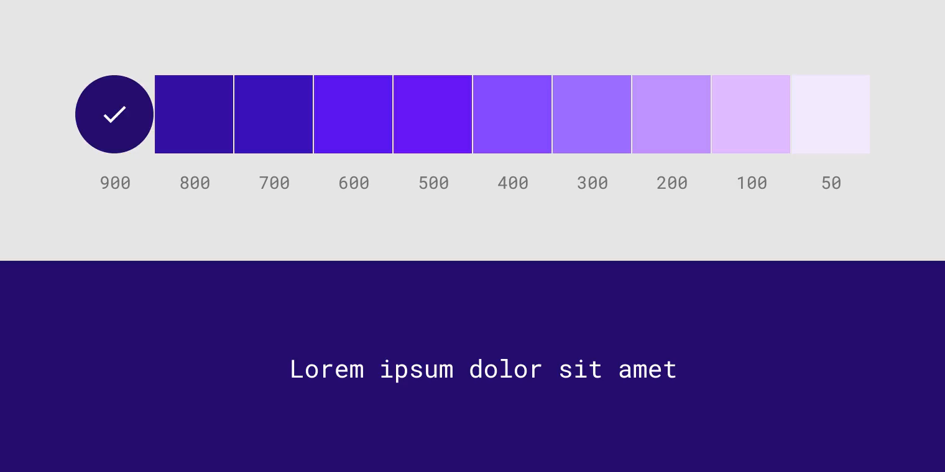
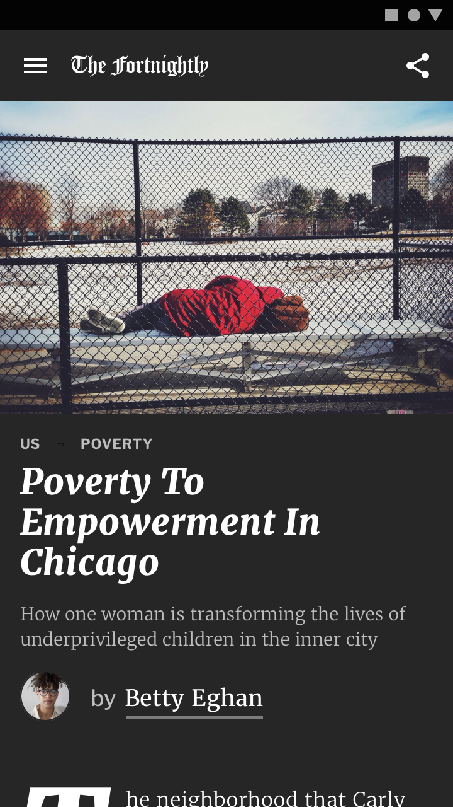
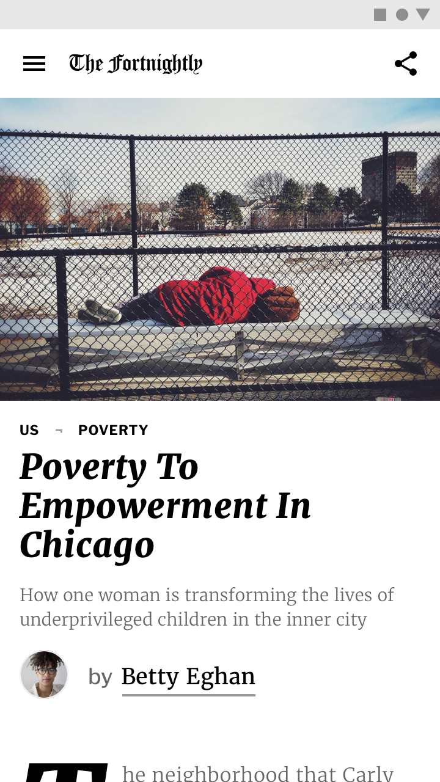
Alternative colors
Adaptive theming
The Material Design color system supports alternative colors, which are colors used as alternatives to your brand’s primary and secondary colors (they constitute additional colors to your theme).
Alternative colors can be used to distinguish different sections of a UI.
Alternative colors are best for:
Apps with light and dark themes
Apps with different themes in different sections
Apps that are part of a suite of products
Alternative colors should be used cautiously, because they can be challenging to implement cohesively with existing color themes.

Slide 31
Alternative colors
The Material Design color system supports alternative colors, which are colors used as alternatives to your brand’s primary and secondary colors (they constitute additional colors to your theme).
Alternative colors can be used to distinguish different sections of a UI.
Alternative colors are best for:
Apps with light and dark themes
Apps with different themes in different sections
Apps that are part of a suite of products
Alternative colors should be used cautiously, because they can be challenging to implement cohesively with existing color themes.

Slide 32
Alternative colors
Dark theme
The Material Design color system supports alternative colors, which are colors used as alternatives to your brand’s primary and secondary colors (they constitute additional colors to your theme).
Alternative colors can be used to distinguish different sections of a UI.
Alternative colors are best for:
Apps with light and dark themes
Apps with different themes in different sections
Apps that are part of a suite of products
Alternative colors should be used cautiously, because they can be challenging to implement cohesively with existing color themes.
A dark theme is a low-light UI that displays mostly dark surfaces.
A dark theme displays dark surfaces across the majority of a UI. It's designed to be a supplemental mode to a default (or light) theme.
Dark themes reduce the luminance emitted by device screens, while still meeting minimum color contrast ratios. They help improve visual ergonomics by reducing eye strain, adjusting brightness to current lighting conditions, and facilitating screen use in dark environments – all while conserving battery power. Devices with OLED screens benefit from the ability to turn off black pixels at any time of day.

Slide 33
Dark theme
A dark theme is a low-light UI that displays mostly dark surfaces.
A dark theme displays dark surfaces across the majority of a UI. It's designed to be a supplemental mode to a default (or light) theme.
Dark themes reduce the luminance emitted by device screens, while still meeting minimum color contrast ratios. They help improve visual ergonomics by reducing eye strain, adjusting brightness to current lighting conditions, and facilitating screen use in dark environments – all while conserving battery power. Devices with OLED screens benefit from the ability to turn off black pixels at any time of day.

Slide 34
Dark theme
A dark theme is a low-light UI that displays mostly dark surfaces.
A dark theme displays dark surfaces across the majority of a UI. It's designed to be a supplemental mode to a default (or light) theme.
Dark themes reduce the luminance emitted by device screens, while still meeting minimum color contrast ratios. They help improve visual ergonomics by reducing eye strain, adjusting brightness to current lighting conditions, and facilitating screen use in dark environments – all while conserving battery power. Devices with OLED screens benefit from the ability to turn off black pixels at any time of day.
Now let’s talk
about Typography!

Slide 35
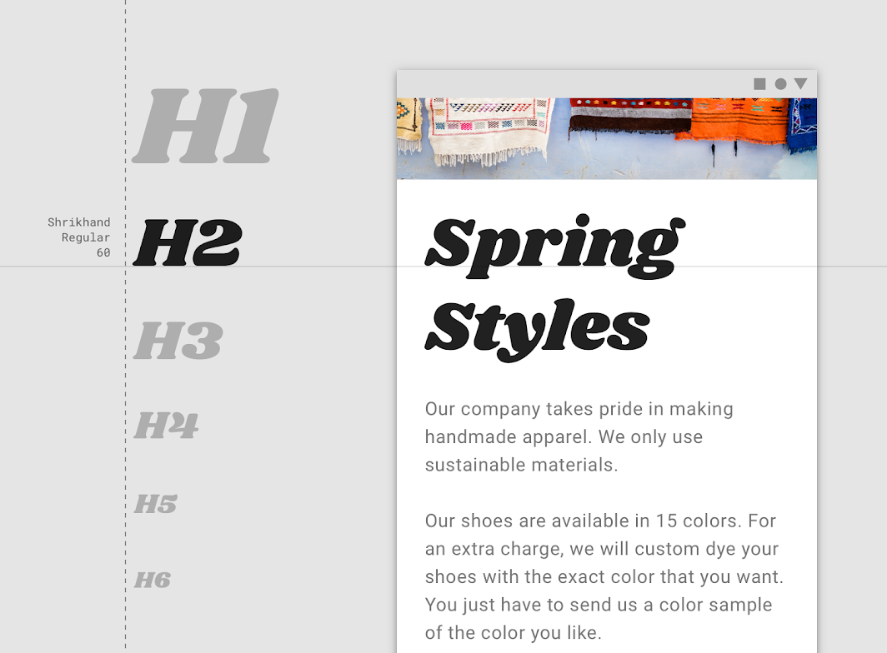
Use typography to present your design and content as clearly and efficiently as possible.
Now let’s talk
about Typography!
Headlines

Slide 36
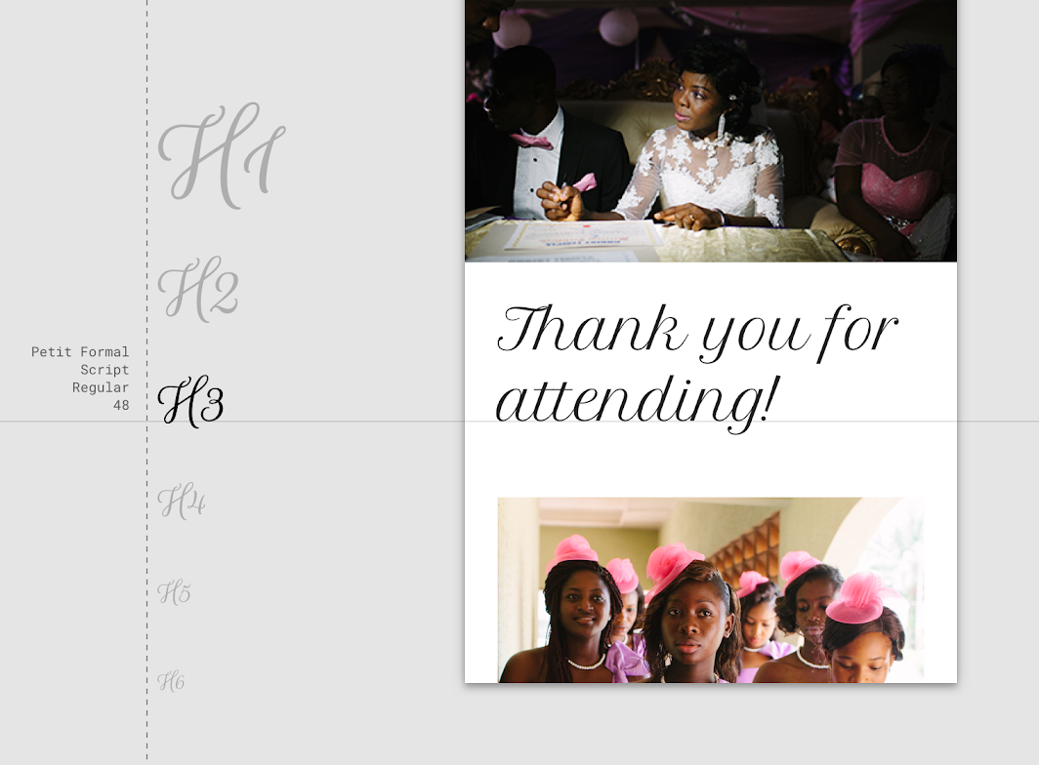
Display style
Heading 2
Headlines

Slide 37
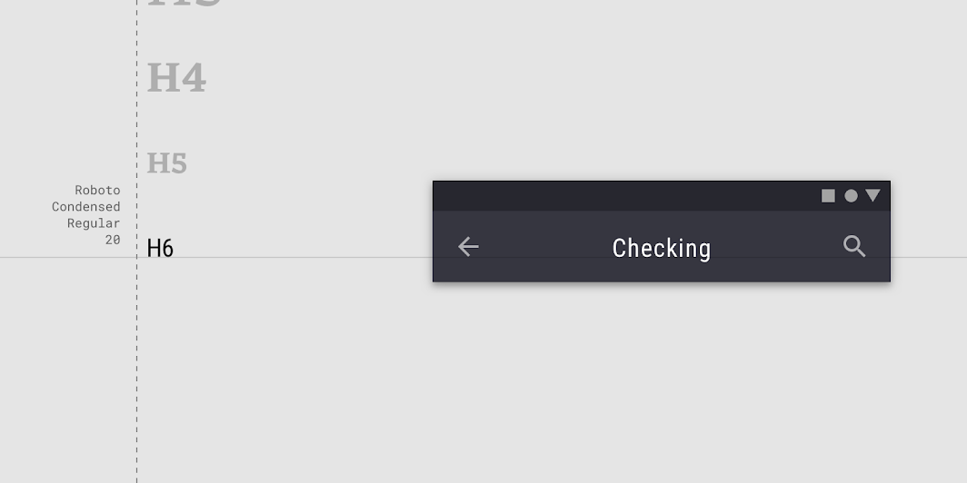
Script style
Heading 3
Headlines

Slide 38
San serif Heading 6
Headlines

Slide 39
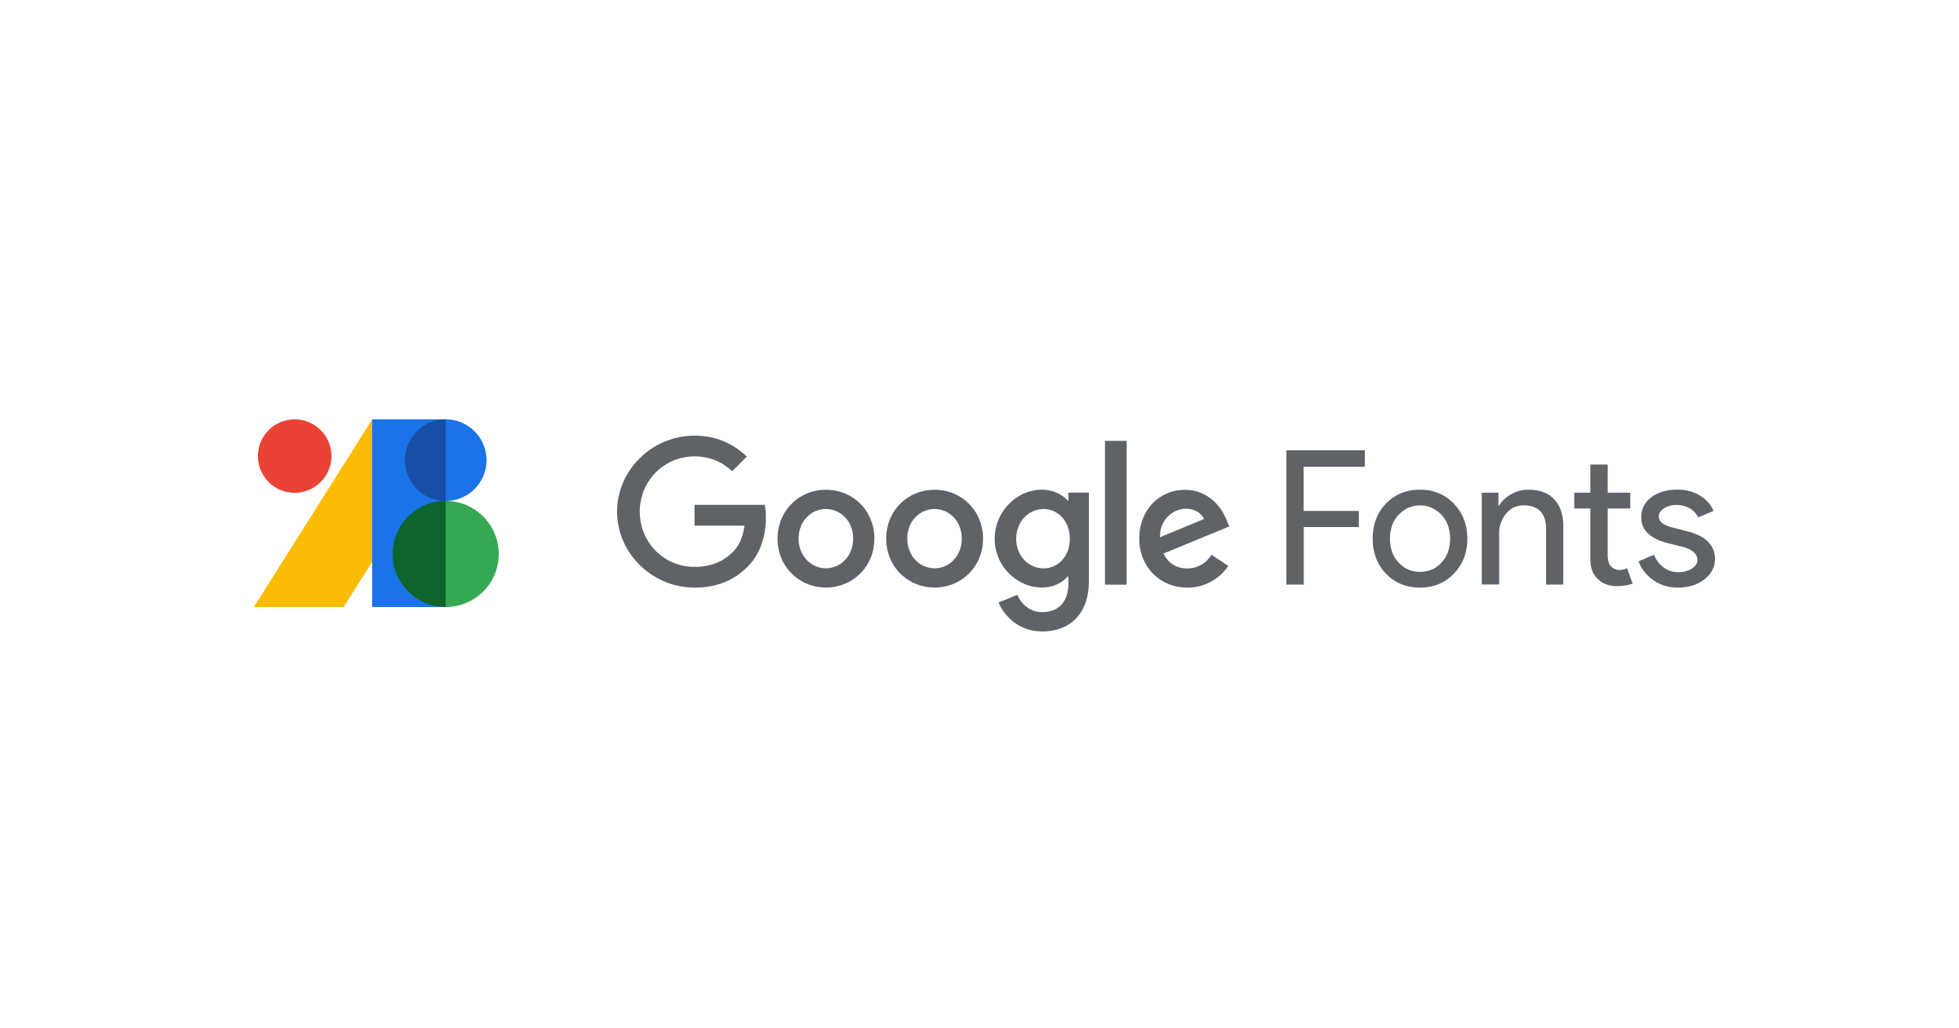
Headlines
For all your typographic needs

Slide 40

thank you
#teamGDSC

